Slide 1

Clustering Customer Reviews for Market Research

Slide 2





GROUP MEMBERS
SOURAV KUMAR JHA
SWARANDIP MANDAL
SWARUPA KUMARI
SHUBHADEEP BERA
VIVEK KUMAR JHA

Slide 3
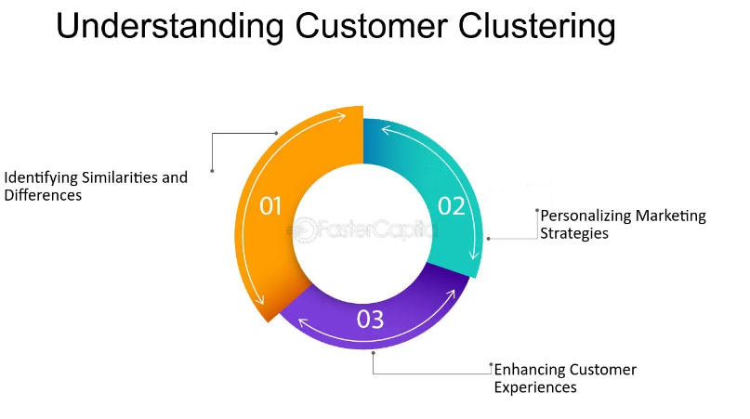
INTRODUCTION
To analyze and cluster customer reviews to uncover common themes and sentiments, helping businesses enhance their products and strategies."

Slide 4

OBJECTIVE
To analyze and cluster customer reviews to identify common themes, sentiments, and patterns in customer feedback, thereby enabling businesses to make informed decisions to improve products, services, and customer experience.

Slide 5
SCOPE
Here’s the scope of clustering customer reviews in simple terms:
Grouping Customers: Clustering helps in grouping customers with similar opinions or behaviors. This makes it easier to understand different types of customers.
Understanding Feelings: By clustering reviews, businesses can see what customers like or dislike. This helps in knowing how happy customers are and what needs to be improved.
Better Marketing: With clustered data, companies can create more personalized ads and offers that appeal to specific groups of customers.
Improving Products: Clustering can show common problems or desired features in products, guiding businesses to make better products.
Enhancing Service: Knowing different customer groups helps in providing better service, making customers happier and more loyal.
Spotting Trends: Clustering can reveal new trends and changes in customer preferences, helping businesses stay ahead.

Slide 6
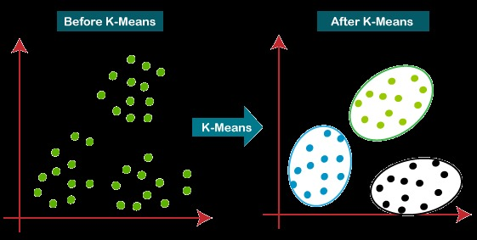
Algorithm(KMeans)
K-Means Clustering is an unsupervised learning algorithm that is used to solve the clustering problems in machine learning.
The main aim of this algorithm is to minimize the sum of distances between the data point and their corresponding clusters.
How does the K-Means Algorithm Work? The working of the K-Means algorithm is explained in the below steps:
Step-1: Select the number K to decide the number of clusters.
Step-2: Select random K points or centroids. (It can be other from the input dataset).
Step-3: Assign each data point to their closest centroid, which will form the predefined K clusters.
Step-4: Calculate the average and place a new centroid of each cluster.
Step-5: Repeat the third steps, until we don't get a saturation point ........
Step-6: Now the centroid point will be terms as mean centroid value.
Step-7: The model is ready.

Slide 7
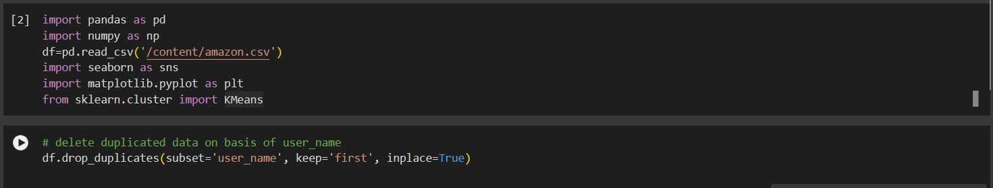
Data collection and dropping duplicate data
"Customer reviews were collected from [amazon] in [CSV] . The dataset includes reviews. We are importing different library
Functions such as (pandas, numpy, seaborn)

Slide 8
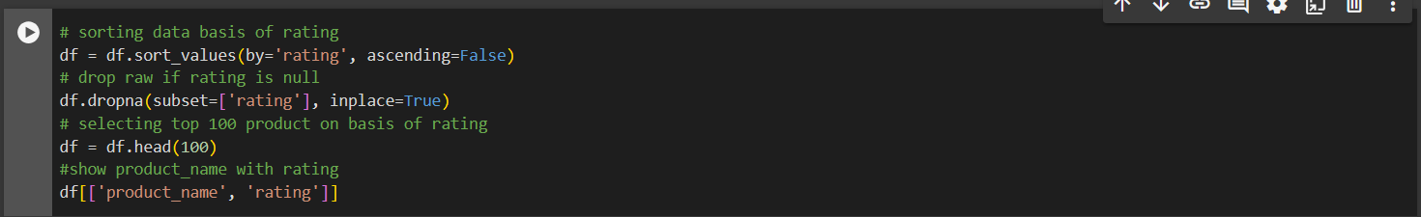
SORTING THE VALUES AND DROPPING THE NULL VALUES

Slide 9
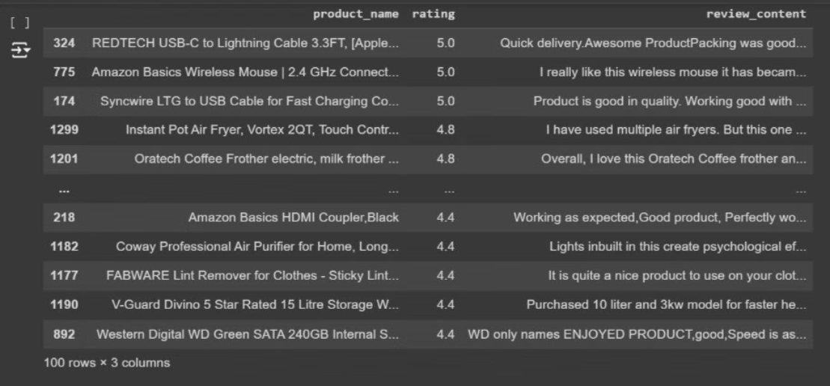
DISPLAYING VALUES OF 100 DATA CONTAINING (product_id,rating and review_content)

Slide 10
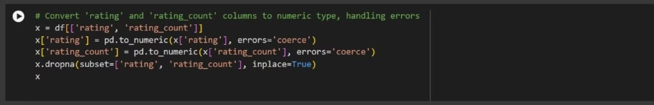
Converting to numeric values

Slide 11
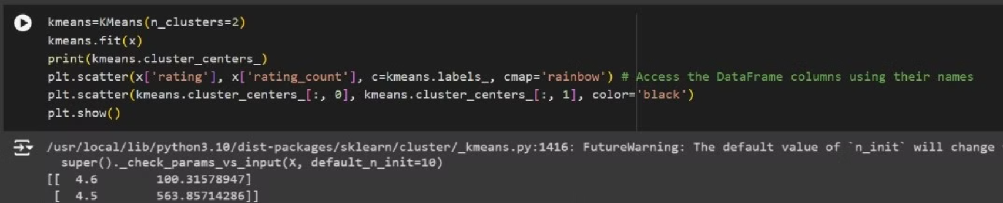
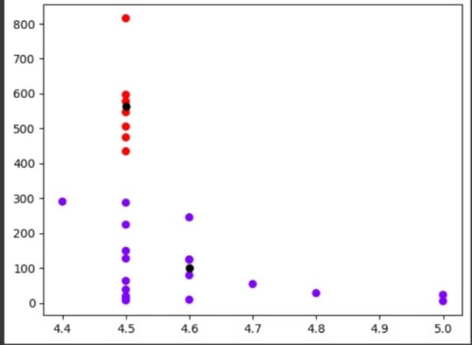
Algorithm(KMeans)

Slide 12
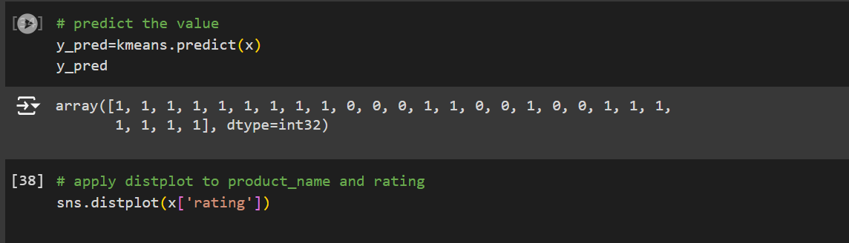
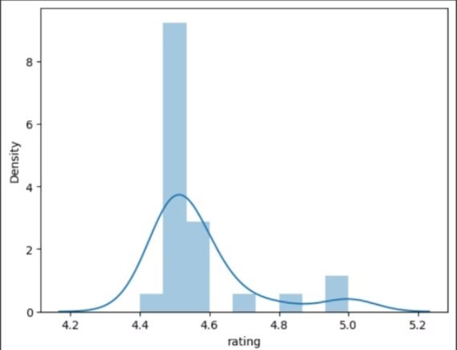
Predicting the value

Slide 13

CONCLUSION
In conclusion, the clustering of customer reviews has proven to be a valuable technique for deriving actionable insights from unstructured feedback. By grouping similar reviews and analyzing these clusters, businesses can gain a deeper understanding of customer sentiments, identify key themes, and make data-driven decisions to enhance their products, services, and marketing strategies. This approach not only improves the quality of the offerings but also aligns them more closely with customer needs and expectations, ultimately leading to a more satisfied and loyal customer base.

Slide 14


